Slide 1
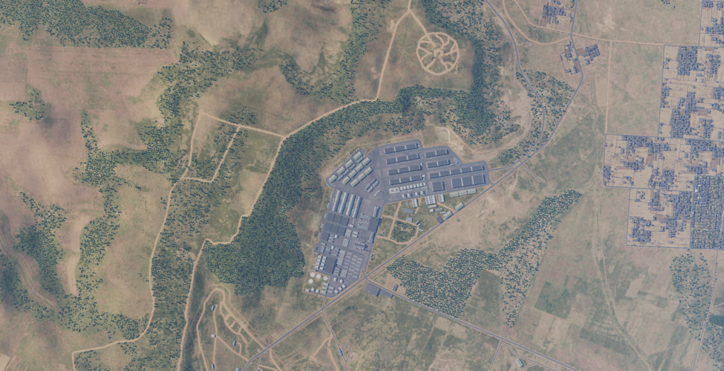

SYTGT075 First Corps Base
N
SYTGT075
075
SYTGT075 A-C: Ordnance storage
SYTGT075 D1-D29: Vehicle storage
SYTGT075 E-J: Office buildings
SYTGT075 K: Power plant
SYTGT075 L1-L17: Barracks
SYTGT075 M1-M4: Fuel
SYTGT075 N1-N11: Ordnance storage
SYTGT075 O1-O3: Officer residence (High Rise Building)
4
5
6
CDE Concern: SYTGT135 Al Safira Chemical Weapons Depot located just SOUTH of SYTGT075.
7
8

Slide 2
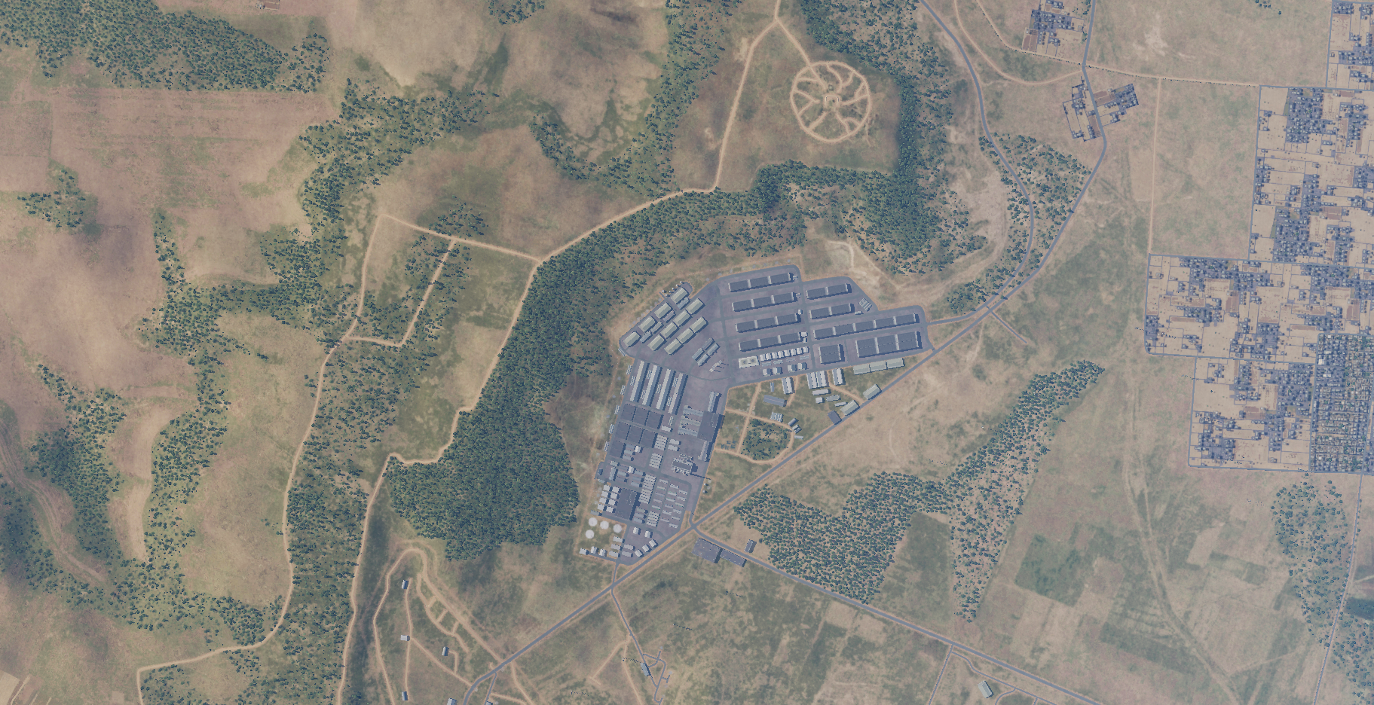
SYTGT075 D1-D29
SYTGT075 N1-N11
SYTGT075 A-C
SYTGT075 O1-O3
SYTGT075 M1-M4
SYTGT075 E-J
SYTGT075 K
SYTGT075 L1-L17

